Slide 1
Unit 4: User Authentication
EECS710: Information Security
Professor Hossein Saiedian
Fall 2014
Notes:
Lecture slides prepared by Dr Lawrie Brown (UNSW@ADFA) for “Computer Security: Principles and Practice”, 1/e, by William Stallings and Lawrie Brown, Chapter 3 “User Authentication”.

Slide 2
overview
Electronic user authentication principles
Password-based authentication
Token-based authentication
Biometric authentication
Remote user authentication
Security issues for user authentication
Practical application: an iris biometric system
Case stury: security problems for ATM systems

Slide 3
User Authentication
Fundamental security building block
  basis of access control & user accountability
The process of verifying an identity claimed by or for a system entity
Two steps:
  identification: specify identifier
  verification: bind entity (person) and identifier
Distinct from message authentication (when communicating parties are concerned with the integrity of the exchanges messages)
Notes:
In most computer security contexts, user authentication is the fundamental building block and the first line of defense. User authentication is the basis of most types of access control and for user accountability. RFC 2828 defines user authentication as:
“The process of verifying an identity claimed by or for a system entity. An authentication process consists of two steps:
Identification step: Presenting an identifier to the security system. (Identifiers should be assigned carefully, because authenticated identities are the basis for other security services, such as access control service.)
Verification step: Presenting or generating authentication information that corroborates the binding between the entity and the identifier.”
In essence, identification is the means by which a user provides a claimed identity to the system; user authentication is the means of establishing the validity of the claim. Note that user authentication is distinct from message authentication.

Slide 4
A model for electronic user authentication
the process of establishing confidence in user identity that are electronically presented
  User applies to registration authority (RA) and becomes a subscriber of a credential service provider (CSP)
  RA is a trusted entity
  The CSP exchanges with the subscriber
  The credential (a data structure) binds an identity to a token possessed by the subscriber
  Claimant: the party to be authenticated
  Verifier: the party verifying
  The verifier passes an assertion about the subscriber to the relaying party (PR)

Slide 5
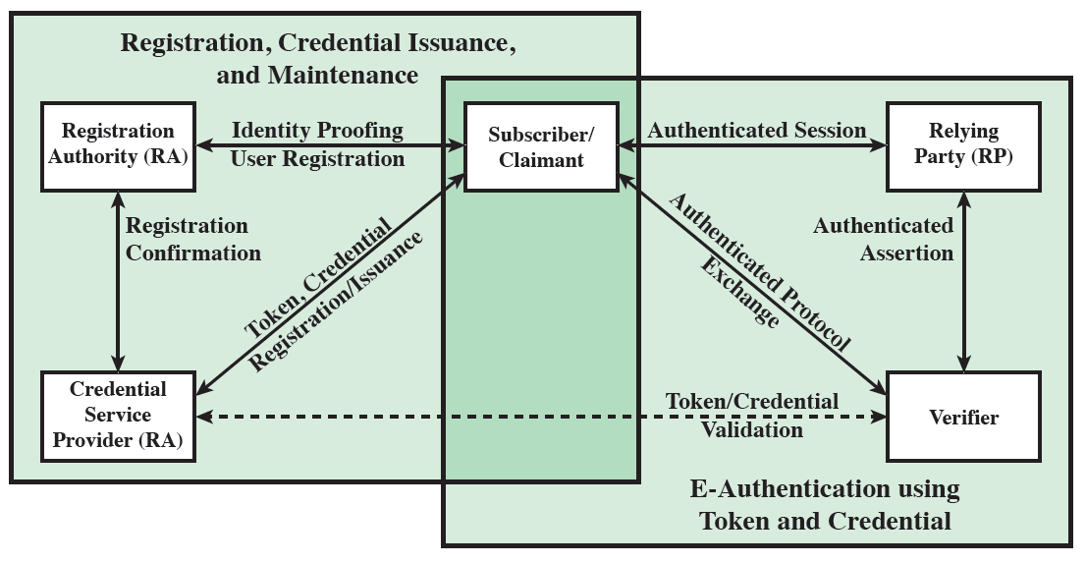
A model for electronic user authentication

Slide 6
Means of user authentication
Four general means of authenticating a user's identity are
• Individual knows: Includes a password, a personal identification number (PIN), or answers to a prearranged set of questions.
• Individual possesses: Includes electronic keycards, smart cards, and physical keys. Also known as a token.
• Individual is (static biometrics): Includes recognition by fingerprint, retina, and face.
• Individual does (dynamic biometrics): Examples include recognition by voice pattern, handwriting characteristics, and typing rhythm.
• can use alone or combined
• all can provide user authentication & have issues.
Notes:
There are four general means of authenticating a user's identity, which can be used alone or in combination:
• Something the individual knows: Examples includes a password, a personal identification number (PIN), or answers to a prearranged set of questions.
• Something the individual possesses: Examples include electronic keycards, smart cards, and physical keys. This type of authenticator is referred to as a token.
• Something the individual is (static biometrics): Examples include recognition by fingerprint, retina, and face.
• Something the individual does (dynamic biometrics): Examples include recognition by voice pattern, handwriting characteristics, and typing rhythm.
All of these methods, properly implemented and used, can provide secure user authentication. However, each method has problems. An adversary may be able to guess or steal a password. Similarly, an adversary may be able to forge or steal a token. A user may forget a password or lose a token. Further, there is a significant administrative overhead for managing password and token information on systems and securing such information on systems. With respect to biometric authenticators, there are a variety of problems, including dealing with false positives and false negatives, user acceptance, cost, and convenience.

Slide 7
Risk assessment for user authentication
Assurance level: the degree of certainty that a user has presented a credential that refers to his/her identity
  Level 1: little confidence (an online forum)
  Level 2: some confidence (professional organizations)
  Level 3: High confidence (patent office applicants)
  Level 4: Very high confidence (employees accessing restricted/sensitive services)
Potential impact: low, moderate, impact

Slide 8
Risk assessment for user authentication
 | Assurance Level Impact Profiles
Potential Impact Categories for Authentication Errors | 1 | 2 | 3 | 4
Inconvenience, distress, or damage to standing or reputation | Low | Mod | Mod | High
Financial loss or organization liability | Low | Mod | Mod | High
Harm to organization programs or interests | None | Low | Mod | High
Unauthorized release of sensitive information | None | Low | Mod | High
Personal safety | None | None | Low | Mod/ High
Civil or criminal violations | None | Low | Mod | High

Slide 9
Password authentication
Widely used user authentication method
  user provides name/login and password
  system compares password with that saved for specified login
Authenticates ID of user logging and
  that the user is authorized to access system
  determines the user’s privileges
  is used in discretionary access control
Notes:
The front line of defense against intruders is the password system. Virtually all multiuser systems require that a user provide not only a name or identifier (ID) but also a password. The system compares the password to a previously stored password for that user ID, maintained in a system password file. The password serves to authenticate the ID of the individual logging on to the system. In turn, the ID determines whether the user is authorized to gain access to a system, the privileges accorded to the user, and is used to determine discretionary access controls.

Slide 10
Password vulnerabilities
offline dictionary attack
specific account attack (user john)
popular password attack (against a wide range of IDs)
password guessing against single user (w/ previous knowledge about the user)
workstation hijacking
exploiting user mistakes
exploiting multiple password use
electronic monitoring
Notes:
We can identify the following attack strategies and countermeasures:
• Offline dictionary attack: A determined hacker may bypass access controls and gain access to the system password file. The attacker then compares the password hashes against hashes of commonly used passwords.
• Specific account attack: The attacker targets a specific account and submits password guesses until the correct password is discovered.
• Popular password attack: The attacker chooses a popular password and try it against a wide range of user IDs.
• Password guessing against single user: The attacker attempts to gain knowledge about the account holder and system password policies and uses that knowledge to guess the password.
• Workstation hijacking; The attacker waits until a logged-in workstation is unattended.
• Exploiting user mistakes: If the system assigns a password, then the user is more likely to write it down because it is difficult to remember.
• Exploiting multiple password use. When different network devices share the same or a similar password for a given user.
• Electronic monitoring: If a password is communicated across a network to log on to a remote system, it is vulnerable to eavesdropping.

Slide 11
Countermeasures for password vulnerability
stop unauthorized access to password file
intrusion detection measures
account lockout mechanisms
policies against using common passwords but rather hard to guess passwords
training & enforcement of policies
automatic workstation logout
encrypted network links
Notes:
Countermeasures against the listed vulnerabilities include controls to: prevent unauthorized access to the password file, intrusion detection measures to identify a compromise, rapid re-issuance of passwords should the password file be compromised; account lockout mechanism which locks out access to the account after a number of failed login attempts; policies to inhibit the selection by users of common passwords; training in and enforcement of password policies that make passwords difficult to guess; automatically logging the workstation out after a period of inactivity; a policy that forbids the same or similar password on particular network devices; encrypted communications links.

Slide 12
Countermeasures for password vulnerability
It is worthwhile to study/research password and password vulnerabilities
  Most common
  Still the most efficient
Notes:
Countermeasures against the listed vulnerabilities include controls to: prevent unauthorized access to the password file, intrusion detection measures to identify a compromise, rapid re-issuance of passwords should the password file be compromised; account lockout mechanism which locks out access to the account after a number of failed login attempts; policies to inhibit the selection by users of common passwords; training in and enforcement of password policies that make passwords difficult to guess; automatically logging the workstation out after a period of inactivity; a policy that forbids the same or similar password on particular network devices; encrypted communications links.

Slide 13
Attack Strategies
1. Offline dictionary attack:
• A hacker gain access to the system password file.
• Compares the password hashes against hashes of commonly used passwords.
2. Specific account attack:
• Attacker targets a specific account &submits password guesses until the correct password is discovered.
3. Popular password attack / Against single user:
• The attacker chooses a popular password and tries it.
• Attacker attempts to gain knowledge about the account holder and system password policies and uses that knowledge to guess the password.
4. Workstation hijacking:
The attacker waits until a logged-in workstation is unattended.
Exploiting user mistakes:
• User is more likely to write it down passwords, because it is difficult to remember.
6. Exploiting multiple password use.
• Similar password for a many applications
7. Electronic monitoring:
• If a password is communicated across a network to log on to a remote system, it is vulnerable to eavesdropping.

Slide 14
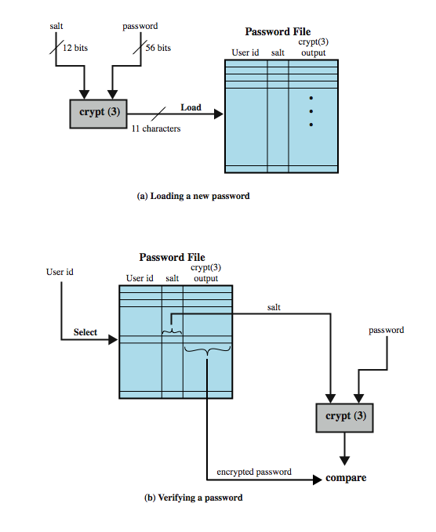
Use of hashed passwords
Notes:
A widely used password security technique is the use of hashed passwords and a salt value. This scheme is found on virtually all UNIX variants as well as on a number of other operating systems. The procedure shown here in Figure 3.1a from the text is used. To load a new password into the system, the user selects or is assigned a password.This password is combined with a fixed-length salt value (so the same user password can create multiple hash values, depending on which salt is used. to make attacks harder). In older implementations, the salt is related to the time the password is assigned to the user. Newer implementations use a pseudorandom or random number. The password and salt serve as inputs to a hashing algorithm to produce a fixed-length hash code. The hash algorithm is designed to be slow to execute to thwart attacks. The hashed password is then stored, together with a plaintext copy of the salt, in the password file for the corresponding user ID. The hashed-password method has been shown to be secure against a variety of cryptanalytic attacks. When a user attempts to log on to a system, the user provides an ID and a password (as shown in Figure 3.1b). The operating system uses the ID to index into the password file and retrieve the plaintext salt and the encrypted password. The salt and user-supplied password are used as input to the encryption routine. If the result matches the stored value, the password is accepted. There are two threats to this password scheme. First, a user can gain access on a machine using a guest account or by some other means and then run a password guessing program, called a password cracker, on that machine. In addition, if an opponent is able to obtain a copy of the password file, then a cracker program can be run on another machine at leisure. This enables the opponent to run through millions of possible passwords in a reasonable period.

Slide 15
Why a salt value?
Prevents duplicate passwords from being visible in the password file
Increases the difficulty of offline dictionary attacks
Nearly impossible to tell if a person used the same password on multiple systems

Slide 16
UNIX Implementation
Original scheme
  8 character password form 56-bit key
  12-bit salt used to modify DES encryption into a one-way hash function
  output translated to 11 character sequence
Now regarded as woefully insecure
  e.g. supercomputer, 50 million tests, 80 min
Sometimes still used for compatibility
Notes:
Since the original development of UNIX, most implementations have relied on the following password scheme. Each user selects a password of up to eight printable characters in length. This is converted into a 56-bit value (using 7-bit ASCII) that serves as the key input to an encryption routine. The hash routine, known as crypt(3), is based on DES. A 12-bit salt value is used. The modified DES algorithm is executed with a data input consisting of a 64-bit block of zeros. The output of the algorithm then serves as input for a second encryption. This process is repeated for a total of 25 encryptions. The resulting 64-bit output is then translated into an 11-character sequence. The modification of the DES algorithm converts it into a one-way hash function, designed to discourage guessing attacks. Software implementations of DES are slow compared to hardware versions, and the use of 25 iterations multiplies the time required by 25. This particular implementation is now considered woefully inadequate. [PERR03] reports the results of a dictionary attack using a supercomputer. The attack was able to process over 50 million password guesses in about 80 minutes. Further, the results showed that for about $10,000 anyone should be able to do the same in a few months using one uniprocessor machine. Despite its known weaknesses, this UNIX scheme is still often required for compatibility with existing account management software or in multi-vendor environments.

Slide 17
Improved implementations
Have other, stronger, hash/salt variants
Many systems now use MD5
  with 48-bit salt
  password length is unlimited
  is hashed with 1000 times inner loop
  produces 128-bit hash
OpenBSD uses Blowfish block cipher based and hash algorithm called Bcrypt
  uses 128-bit salt to create 192-bit hash value
Notes:
There are other, much stronger, hash/salt schemes available for UNIX. FreeBSD is an open source UNIX implementation that is widely used. The recommended hash function for many UNIX systems, including Linux, Solaris, and FreeBSD, is based on the MD5 secure hash algorithm (which is similar to, but not as secure as SHA-1). The MD5 crypt routine uses a salt of up to 48 bits and effectively has no limitations on password length. It produces a 128-bit hash value. It is also far slower than crypt(3). To achieve the slowdown, MD5 crypt uses an inner loop with 1000 iterations. Probably the most secure version of the UNIX hash/salt scheme was developed for OpenBSD, another widely used open source UNIX. This scheme, reported in [PROV99], uses a hash function based on the Blowfish symmetric block cipher. The hash function, called Bcrypt,is quite slow to execute. Bcrypt allows passwords of up to 55 characters in length and requires a random salt value of 128 bits, to produce a 192-bit hash value. Bcrypt also includes a cost variable; an increase in the cost variable causes a corresponding increase in the time required to perform a Bcyrpt hash. The cost assigned to a new password is configurable, so that administrators can assign a higher cost to privileged users.

Slide 18
Password Cracking
Dictionary attacks
  Develop a large dictionary of possible passwords and try each against the password file
  Each password must be hashed using each salt value and then compared to stored hash values
  Rainbow table attacks
  Pre-compute tables of hash values for all salts
  A mammoth table of hash values
  Can be countered by using a sufficiently large salt value and a sufficiently large hash length
  not feasible if larger salt values used
Notes:
The traditional approach to password guessing, or password cracking as it is called, is to develop a large dictionary of possible passwords and to try each of these against the password file. This means that each password must be hashed using each available salt value and then compared to stored hash values. If no match is found, then the cracking program tries variations on all the words in its dictionary of likely passwords. Such variations include backward spelling of words, additional numbers or special characters, or sequence of characters, An alternative is to trade off space for time by precomputing potential hash values. In this approach the attacker generates a large dictionary of possible passwords. For each password, the attacker generates the hash values associated with each possible salt value. The result is a mammoth table of hash values known as a rainbow table. For example, [OECH03] showed that using 1.4 GB of data, he could crack 99.9% of all alphanumeric Windows password hashes in 13.8 seconds. This approach can be countered by using a sufficiently large salt value and a sufficiently large hash length. Both the FreeBSD and OpenBSD approaches should be secure from this attack for the foreseeable future.

Slide 19
Password choices/concerns
users may pick short passwords
  e.g. 3% were 3 chars or less, easily guessed
  system can reject choices that are too short
users may pick guessable passwords
  so crackers use lists of likely passwords
  e.g. one study of 14000 encrypted passwords guessed nearly 1/4 of them
  would take about 1 hour on fastest systems to compute all variants, and only need 1 break!
Notes:
Some users, when permitted to choose their own password, pick one that is absurdly short. The results of one study at Purdue University are shown in Table 3.1 in the text which observed password change choices on 54 machines, representing approximately 7000 user accounts. Almost 3% of the passwords were three characters or fewer in length. An attacker could begin the attack by exhaustively testing all possible passwords of length 3 or fewer. A simple remedy is for the system to reject any password choice that is too small. Many people, when permitted to choose their own password, pick a password that is guessable, such as their own name, their street name, a common dictionary word, and so forth. This makes the job of password cracking straightforward. The cracker simply has to test the password file against lists of likely passwords. One study of nearly 14,000 encrypted password, was tested, with results, which the author rightly characterizes as frightening, shown in Table 3.2 in the text, where nearly one-fourth of the passwords were guessed. The test involved about 3 million words. Using the fastest Thinking Machines implementation listed earlier, the time to encrypt all these words for all possible salt values is under an hour. Keep in mind that such a thorough search could produce a success rate of about 25%, whereas even a single hit may be enough to gain a wide range of privileges on a system.

Slide 20
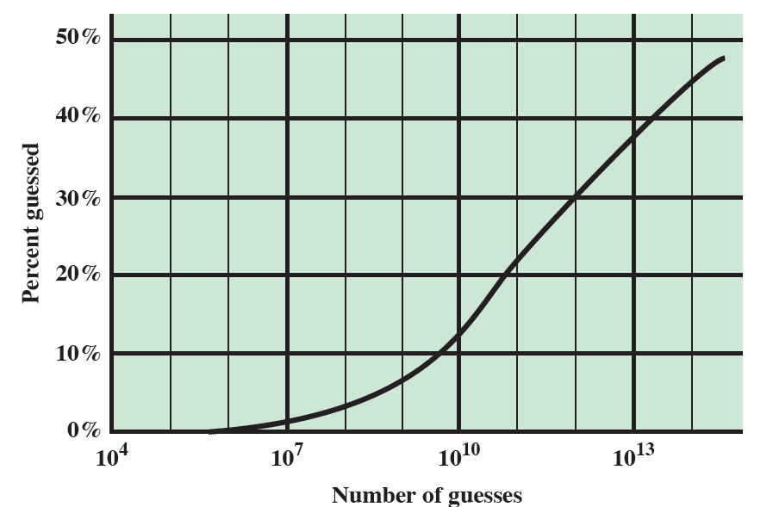
Another case study
An analysis of passwords used by 25,000 students
Over 10% recovered after 10^10 guesses

Slide 21
Password File Access Control
Can block offline guessing attacks by denying access to encrypted passwords
  make available only to privileged users
  often using a separate shadow password (for su only)
Still have vulnerabilities
  exploit O/S bug
  accident with permissions making it readable
  users with same password on other systems
  access from unprotected backup media
  sniff passwords in unprotected network traffic
Notes:
One way to thwart a password attack is to deny the opponent access to the password file. If the hashed password portion of the file is accessible only by a privileged user, then the opponent cannot read it without already knowing the password of a privileged user. Often, the hashed passwords are kept in a separate file from the user IDs, referred to as a shadow password file. Special attention is paid to making the shadow password file protected from unauthorized access. Although password file protection is certainly worthwhile, there remain vulnerabilities: a hacker may be able to exploit a software vulnerability in the operating system to bypass the access control system long enough to extract the password file; an accident of protection might render the password file readable; some users may use the same password on other less protected or compromised machines; a lack of or weakness in physical security (e.g. of backups) may provide opportunities for a hacker to access a copy of the file; passwords may be captured by sniffing network traffic.

Slide 22
Using Better Passwords
Clearly have problems with passwords
Goal to eliminate guessable passwords
  Still easy for user to remember
Techniques
  user education
  computer-generated passwords
  reactive password checking (periodic checking)
  proactive password checking (at the time of selection)
Notes:
The lesson from the two experiments just described (Tables 3.1and 3.2) is that, when not constrained,many users choose a password that is too short or too easy to guess. At the other extreme,if users are assigned passwords consisting of eight randomly selected printable characters, password cracking is effectively impossible. But it would be almost as impossible for most users to remember their passwords. Fortunately, even if we limit the password universe to strings of characters that are reasonably memorable, the size of the universe is still too large to permit practical cracking. Our goal, then, is to eliminate guessable passwords while allowing the user to select a password that is memorable. Four basic techniques are in use:
• User education - Users can be told the importance of using hard-to-guess passwords and can be provided with guidelines for selecting strong passwords. Can be problematic when have a large user population or a lot of turnover, and because many users will simply ignore the guidelines.
• Computer-generated passwords - have a history of poor acceptance by users, if random in nature, users will not remember them, if pronounceable, the user may still be tempted to write it down.
• Reactive password checking - where the system periodically runs its own password cracker to find guessable passwords.The system cancels any passwords that are guessed and notifies the user. Can be costly in resources to implement.
• Proactive password checking - where user selects own password which the system then checks to see if it is is allowable and, if not, rejects it. It must strike a balance between user acceptability and strength. Likely the best solution.

Slide 23
1. User education:
• Users can be told the importance of using hard-to-guess passwords.
• Provide users with guidelines for selecting strong passwords.
• Can be problematic when have a large user population.
• Because many users will simply ignore the guidelines.
2.computer-generated passwords
Poor acceptance by users.
• Random in nature, users will not remember.
3. Reactive password checking:
• System periodically runs its own password cracker to find guessable passwords.
• The system cancels any passwords that are guessed and notifies the user.
• Can be costly in resources to implement.
4. Proactive password checking:
• User selects own password which the system then checks to see if it is allowable and, if not, rejects it.

Slide 24
Proactive Password Checking
Rule enforcement plus user advice, e.g.
  8+ chars, upper/lower/numeric/punctuation
  may not suffice
Password cracker
  list of bad passwords
  time and space issues
Markov Model
  generates guessable passwords
  hence reject any password it might generate
Bloom Filter
  use to build table based on dictionary using hashes
  check desired password against this table
Notes:
Now look at possible approaches to proactive password checking.
The first approach is a simple system for rule enforcement coupled with advice to the user, e.g:
• All passwords must be at least eight characters long.
• In the first eight characters, the passwords must include at least one each of uppercase, lowercase, numeric digits, and punctuation marks.
Another method is to compile a large dictionary of possible “bad”passwords. When a user selects a password, the system runs a Password Cracker to make sure that it is not on the disapproved list. This still consumes significant time and space.
Use a Markov Model for the generation of guessable passwords, and reject any passwords likely to be generated by the model (see text for more details).
Use a Bloom filter, which is a set of k independent hash functions which map a password into a set of hash values in the range 0 … N–1. These are used to set bits in a lookup table of size N. When a new password is presented to the checker, its k hash values are calculated. If all the corresponding bits of the hash table are equal to 1, then the password is rejected. All passwords in the dictionary will be rejected. But there will also be some other “false positives” (see text for more details).

Slide 25
Token-based authentication
Object user possesses to authenticate, e.g.
  memory card (magnetic stripe)
  smartcard
Notes:
Objects that a user possesses for the purpose of user authentication are called tokens. Now examine two types of tokens that are widely used, which are cards that have the appearance and size of bank cards, as detailed in Table 3.3 in the text. These include:
Embossed - Raised characters only, on front, e.g. Old credit card
Magnetic stripe - Magnetic bar on back, characters on front, e.g. Bank card
Memory - has Electronic memory inside, e.g. Prepaid phone card
Smartcard - has Electronic memory and processor inside, e.g. Biometric ID card

Slide 26
Memory Card
store but do not process data
magnetic stripe card, e.g. bank card
electronic memory card
used alone for physical access (e.g., hotel rooms)
some with password/PIN (e.g., ATMs)
Drawbacks of memory cards include:
  need special reader
  loss of token issues
  user dissatisfaction (OK for ATM, not OK for computer access)
Notes:
Memory cards can store but not process data. The most common such card is the bank card with a magnetic stripe on the back. A magnetic stripe can store only a simple security code, which can be read (and unfortunately reprogrammed) by an inexpensive card reader. There are also memory cards that include an internal electronic memory. Memory cards can be used alone for physical access, such as a hotel room. For computer user authentication, such cards are typically used with some form of password or personal identification number (PIN). A typical application is an automatic teller machine (ATM). The memory card, when combined with a PIN or password, provides significantly greater security than a password alone. An adversary must gain physical possession of the card (or be able to duplicate it) plus must gain knowledge of the PIN. Among the potential drawbacks are the following [NIST95]:
• Requires special reader: This increases the cost of using the token and creates the requirement to maintain the security of the reader’s hardware and software.
• Token loss: A lost token temporarily prevents its owner from gaining system access. Thus there is an administrative cost in replacing the lost token. In addition, if the token is found, stolen, or forged, then an adversary now need only determine the PIN to gain unauthorized access.
• User dissatisfaction: Although users may have no difficulty in accepting the use of a memory card for ATM access, its use for computer access may be deemed inconvenient.

Slide 27
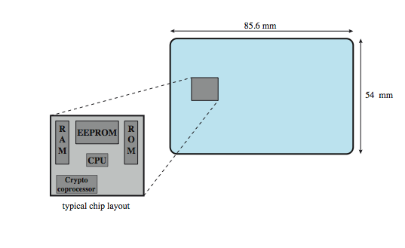
Smartcard/Embosed
credit-card like
has own processor, memory, I/O ports
  ROM, EEPROM, RAM memory
executes protocol to authenticate with reader/computer
  static: similar to memory cards
  dynamic: passwords created every minute; entered manually by user or electronically
  challenge-response: computer creates a random number; smart card provides its hash (similar to PK)
also have USB dongles
Notes:
For user authentication to computer, the most important category of smart token is the smart card, which has the appearance of a credit card, has an electronic interface, and may use any of the possible authentication protocols (static, dynamic password, challenge-response; see text). A smart card contains within it an entire microprocessor, including processor, memory, and I/O ports, as shown in Figure 3.4 from the text. Some versions incorporate a special co-processing circuit for cryptographic operation to speed the task of encoding and decoding messages or generating digital signatures to validate the information transferred. In some cards, the I/O ports are directly accessible by a compatible reader by means of exposed electrical contacts. Other cards rely instead on an embedded antenna for wireless communication with the reader. A typical smart card includes three types of memory. Read-only memory (ROM) stores data that does not change during the card’s life, such as the card number and the cardholder’s name. Electrically erasable programmable ROM (EEPROM) holds application data and programs, such as the protocols that the card can execute. It also holds data that may vary with time. Random access memory (RAM) holds temporary data generated when applications are executed. Figure 3.5 in the text illustrates a typical interaction between a smart card and a reader or computer system. An alternative to the smart card is a small, inexpensive flash memory device known as a USB dongle. It has the same functionality as a smart card, but connects to the existing USB port on a computer, hence it does not need a specific card reader.

Slide 28
Electronic identify cards
An important application of smart cards
A national e-identity (eID)
Serves the same purpose as other national ID cards (e.g., a driver’s licence)
  Can provide stronger proof of identity
  A German card
    Personal data, Document number, Card access number (six digit random number), Machine readable zone (MRZ): the password
    Uses: ePass (government use), eID (general use), eSign (can have private key and certificate)

Slide 29
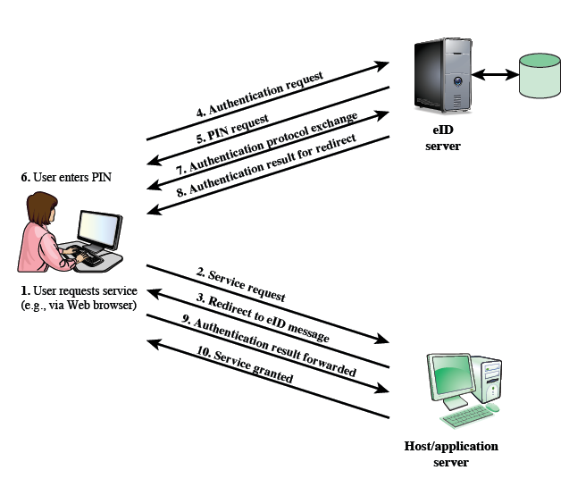
User authentication with eID

Slide 30
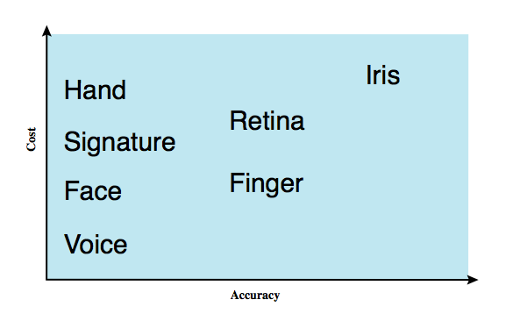
Biometric authentication
Authenticate user based on one of their physical characteristics:
  facial
  fingerprint
  hand geometry
  retinal pattern
  Iris pattern
  signature
  voice
Notes:
A biometric authentication system attempts to authenticate an individual based on unique physical characteristics.These include static characteristics, such as fingerprints, hand geometry, facial characteristics, and retinal and iris patterns; and dynamic characteristics, such as voiceprint and signature. Compared to passwords and tokens, biometric authentication is both technically complex and expensive, and have yet to mature as a standard tool for user authentication to computer systems. Figure 3.6 from the text gives a rough indication of the relative cost and accuracy of the most common biometric measures:
• Facial characteristics: define characteristics based on relative location and shape of key facial features, such as eyes, eyebrows, nose, lips, and chin shape.
• Fingerprints: the pattern of ridges and furrows on the surface of the fingertip, believed to be unique across the entire human population. Automated fingerprint systems extract a number of features to use as a surrogate for the full pattern.
• Hand geometry: identify features of hand,: e.g. shape, lengths & widths of fingers.
• Retinal pattern: formed by veins beneath the retinal surface is unique and therefore suitable for identification. Uses a digital image of the retinal pattern by projecting a low-intensity beam of visual or infrared light into the eye.
• Iris: Another unique physical characteristic is the detailed structure of the iris.
• Signature: each individual has a unique style of handwriting, esp in signature.
• Voice: patterns are more closely tied to physical and anatomical characteristics of the speaker, but still have a variation from sample to sample over time from the same speaker,complicating the biometric recognition task.

Slide 31
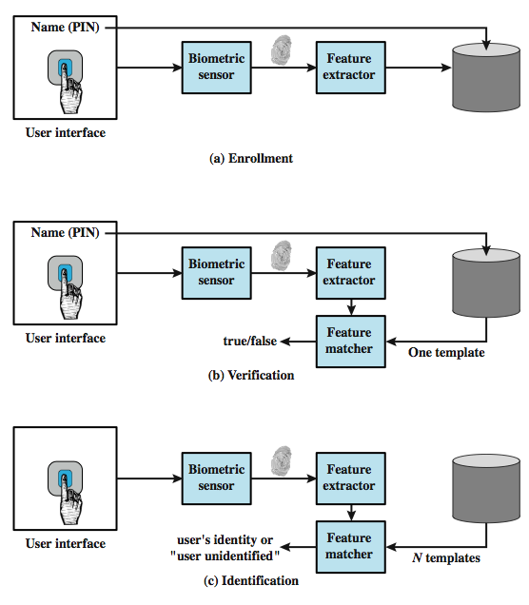
Operation of a biometric system
Verification is analogous to user login via a smart card and a PIN
Identification is biometric info but no IDs; system compares with stored templates
Notes:
Figure 3.7 from the text illustrates the operation of a biometric system. Each individual who is to be included in the database of authorized users must first be enrolled in the system. This is analogous to assigning a password to a user .For a biometric system, the user presents a name and, typically, some type of password or PIN to the system. At the same time the system senses some biometric characteristic of this user (e.g. fingerprint of right index finger). The system digitizes the input and then extracts a set of features that can be stored as a number or set of numbers representing this unique biometric characteristic ;this set of numbers is referred to as the user’s template. The user is now enrolled in the system, which maintains for the user a name (ID), perhaps a PIN or password, and the biometric value. Depending on application, user authentication on a biometric system involves either verification or identification. Verification is analogous to a user logging on to a system by using a memory card or smart card coupled with a password or PIN. For biometric verification, the user enters a PIN and also uses a biometric sensor. The system extracts the corresponding feature and compares that to the template stored for this user. If there is a match, then the system authenticates this user. For an identification system, the individual uses the biometric sensor but presents no additional information. The system then compares the presented template with the set of stored templates. If there is a match, then this user is identified. Otherwise, the user is rejected.

Slide 32
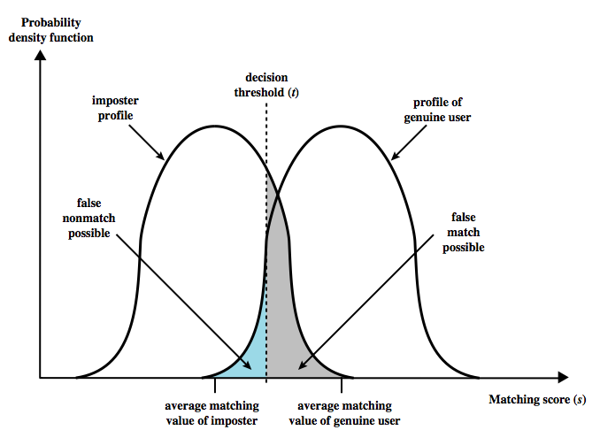
Biometric Accuracy
The system generates a matching score (a number) that quantifies similarity between the input and the stored template
Concerns: sensor noise and detection inaccuracy
Problems of false match/false non-match
Notes:
In any biometric scheme, some physical characteristic of the individual is mapped into a digital representation. For each individual, a single digital representation, or template, is stored in the computer. When the user is to be authenticated, the system compares the stored template to the presented template. Given the complexities of physical characteristics, we cannot expect that there will be an exact match between the two templates. Rather, the system uses an algorithm to generate a matching score (typically a single number) that quantifies the similarity between the input and the stored template. Figure 3.8 illustrates the dilemma posed to the system. If a single user is tested by the system numerous times, the matching score swill vary, with a probability density function typically forming a bell curve, as shown. On average, any other individual should have a much lower matching score but again will exhibit a bell-shaped probability density function .The difficulty is that the range of matching scores produced by two individuals, one genuine and one an imposter, compared to a given reference template, are likely to overlap. In Figure 3.8 a threshold value is selected so that if the presented value is s>=t then a match is assumed, and for s< t, a mismatch is assumed. The shaded part to the right of t indicates a range of values for which a false match is possible, and the shaded part to the left indicates a range of values for which a false nonmatch is possible. The area of each shaded part represents to probability of a false match or nonmatch, respectively. By moving the threshold, left or right, the probabilities can be altered, but note that an decrease in false match rate necessarily results in an increase in false nonmatch rate, and vice versa.

Slide 33
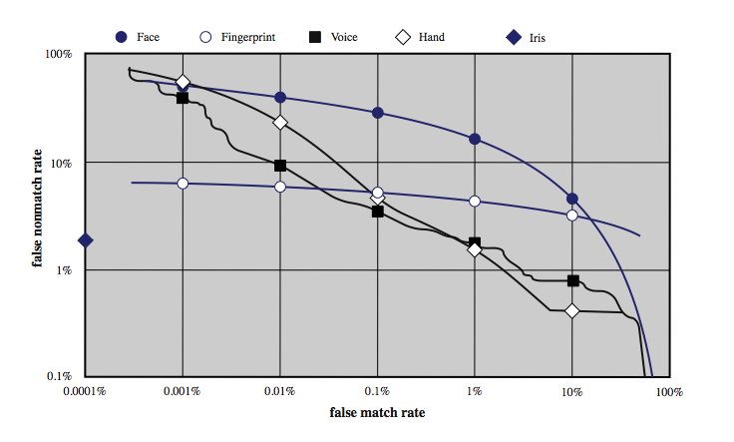
Biometric Accuracy
Can plot characteristic curve (2,000,000 comparisons)
Pick threshold balancing error rates
Notes:
For a given biometric scheme, we can plot the false match versus false non-match rate, called the operating characteristic curve. Figure 3.9 in the text shows representative curves for two different systems. A reasonable tradeoff is to pick a threshold t that corresponds to a point on the curve where the rates are equal. A high-security application may require a very low false match rate, resulting in a point farther to the left on the curve. For a forensic application, in which the system is looking for possible candidates, to be checked further, the requirement may be for a low false non-match rate. Figure 3.10 on this slide from the text, shows characteristic curves developed from actual product testing. The iris system had no false matches in over 2 million cross-comparisons. Note that over a broad range of false match rates, the face biometric is the worst performer.

Slide 34
Remote User Authentication
Authentication over network more complex
  Problems of eavesdropping, replay
Generally use challenge-response
  user sends identity
  host responds with random number r
  user computes f(r,h(P)) and sends back
  host compares value from user with own computed value, if match user authenticated
Protects against a number of attacks
Notes:
The simplest form of user authentication is local authentication, in which a user attempts to access a system that is locally present, such as a stand-alone office PC or an ATM machine. The more complex case is that of remote user authentication, which takes place over the Internet, a network, or a communications link. Remote user authentication raises additional security threats, such as an eavesdropper being able to capture a password, or an adversary replaying an authentication sequence that has been observed. To counter threats to remote user authentication, systems generally rely on some form of challenge-response protocol. The user first transmits his or her identity to the emote host. The host generates a random number r, often called a nonce, and returns this nonce to the user, known as the challenge. The user’s response is the result of computing a function on the random number and a hash of the password: f(r,h(P)). The host stores the hash function of each register user’s password. When the response arrives, the host compares the incoming vakue to that it calculates. If the quantities match, the user is authenticated. This scheme defends against several forms of attack.The host stores only a hash code of the password, which secures the password from intruders into the host system. Also only a function of the password hash is sent, so it cannot be captured during transmission. Finally, the use of a random number as one of the arguments defends against a replay attack. The text includes details of variants using tokens, static biometrics and dynamic biometrics.

Slide 35
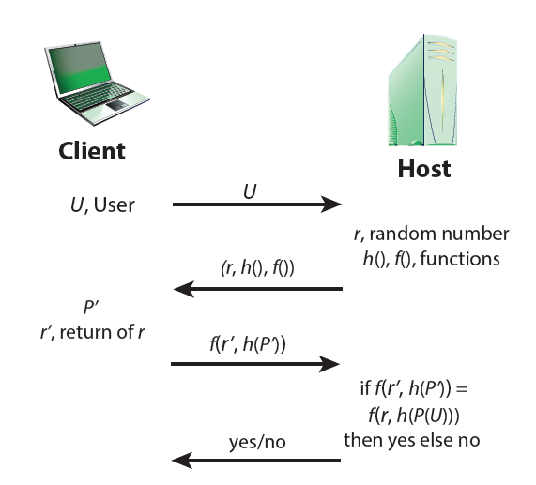
Protocol for a password verification
Similar approach for token and biometric verification

Slide 36
Authentication Security Issues
Client attacks: attacker attempts to achieve user authentication without access to the remote host
  Masquerade as a legitimate user (e.g., guess the password or try all passwords)
  Countermeasure: strong passwords; limit number of attempts
Notes:
As with any security service,user authentication,particularly remote user authentication, is subject to a variety of attacks, as presented in Table 3.4 in the text. Client attacks are those in which an adversary attempts to achieve user authentication without access to the remote host or to the intervening communications path. The adversary attempts to masquerade as a legitimate user. e.g. in a password-based system, the adversary may attempt to guess the likely user password. Host attacks are directed at the user file at the host where passwords,token passcodes, or biometric templates are stored. Eavesdropping refers to an adversary’s attempt to learn the password by observing the user, finding a written copy of the password, keystroke logging, etc. Replay attacks involve an adversary repeating a previously captured user response. The most common countermeasure to such attacks is the challenge- response protocol. In a Trojan horse attack, an application or physical device masquerades as an authentic application or device for the purpose of capturing a user password, passcode, or biometric. The adversary can then use the captured information to masquerade as a legitimate user. A denial-of-service attack attempts to disable a user authentication service by flooding the service with numerous authentication attempts.

Slide 37
Authentication Security Issues
Host attacks: attacker attacks the host where passwords/passcodes are stored
  Countermeasure: hashing, protect password databases
Notes:
As with any security service,user authentication,particularly remote user authentication, is subject to a variety of attacks, as presented in Table 3.4 in the text. Client attacks are those in which an adversary attempts to achieve user authentication without access to the remote host or to the intervening communications path. The adversary attempts to masquerade as a legitimate user. e.g. in a password-based system, the adversary may attempt to guess the likely user password. Host attacks are directed at the user file at the host where passwords,token passcodes, or biometric templates are stored. Eavesdropping refers to an adversary’s attempt to learn the password by observing the user, finding a written copy of the password, keystroke logging, etc. Replay attacks involve an adversary repeating a previously captured user response. The most common countermeasure to such attacks is the challenge- response protocol. In a Trojan horse attack, an application or physical device masquerades as an authentic application or device for the purpose of capturing a user password, passcode, or biometric. The adversary can then use the captured information to masquerade as a legitimate user. A denial-of-service attack attempts to disable a user authentication service by flooding the service with numerous authentication attempts.

Slide 38
Authentication Security Issues
Eavesdropping: attacker attempts to learn passwords by observing the user, finding written passwords, keylogging
  Countermeasures
    diligence to keep passwords
    multifactor authentication
    admin revoke compromised passwords
Notes:
As with any security service,user authentication,particularly remote user authentication, is subject to a variety of attacks, as presented in Table 3.4 in the text. Client attacks are those in which an adversary attempts to achieve user authentication without access to the remote host or to the intervening communications path. The adversary attempts to masquerade as a legitimate user. e.g. in a password-based system, the adversary may attempt to guess the likely user password. Host attacks are directed at the user file at the host where passwords,token passcodes, or biometric templates are stored. Eavesdropping refers to an adversary’s attempt to learn the password by observing the user, finding a written copy of the password, keystroke logging, etc. Replay attacks involve an adversary repeating a previously captured user response. The most common countermeasure to such attacks is the challenge- response protocol. In a Trojan horse attack, an application or physical device masquerades as an authentic application or device for the purpose of capturing a user password, passcode, or biometric. The adversary can then use the captured information to masquerade as a legitimate user. A denial-of-service attack attempts to disable a user authentication service by flooding the service with numerous authentication attempts.

Slide 39
Authentication Security Issues
Replay: attacker repeats a previously captured user response
  Countermeasure
    Challenge-response
    1-time passcodes
Notes:
As with any security service,user authentication,particularly remote user authentication, is subject to a variety of attacks, as presented in Table 3.4 in the text. Client attacks are those in which an adversary attempts to achieve user authentication without access to the remote host or to the intervening communications path. The adversary attempts to masquerade as a legitimate user. e.g. in a password-based system, the adversary may attempt to guess the likely user password. Host attacks are directed at the user file at the host where passwords,token passcodes, or biometric templates are stored. Eavesdropping refers to an adversary’s attempt to learn the password by observing the user, finding a written copy of the password, keystroke logging, etc. Replay attacks involve an adversary repeating a previously captured user response. The most common countermeasure to such attacks is the challenge- response protocol. In a Trojan horse attack, an application or physical device masquerades as an authentic application or device for the purpose of capturing a user password, passcode, or biometric. The adversary can then use the captured information to masquerade as a legitimate user. A denial-of-service attack attempts to disable a user authentication service by flooding the service with numerous authentication attempts.

Slide 40
Authentication Security Issues
eavesdropping
replay
trojan horse
Notes:
As with any security service,user authentication,particularly remote user authentication, is subject to a variety of attacks, as presented in Table 3.4 in the text. Client attacks are those in which an adversary attempts to achieve user authentication without access to the remote host or to the intervening communications path. The adversary attempts to masquerade as a legitimate user. e.g. in a password-based system, the adversary may attempt to guess the likely user password. Host attacks are directed at the user file at the host where passwords,token passcodes, or biometric templates are stored. Eavesdropping refers to an adversary’s attempt to learn the password by observing the user, finding a written copy of the password, keystroke logging, etc. Replay attacks involve an adversary repeating a previously captured user response. The most common countermeasure to such attacks is the challenge- response protocol. In a Trojan horse attack, an application or physical device masquerades as an authentic application or device for the purpose of capturing a user password, passcode, or biometric. The adversary can then use the captured information to masquerade as a legitimate user. A denial-of-service attack attempts to disable a user authentication service by flooding the service with numerous authentication attempts.

Slide 41
Authentication Security Issues
Trojan horse: an application or physical device masquerades as an authentic application or device
  Countermeasure: authentication of the client within a trusted security environment
Denial of service: attacker attempts to disable a user authentication service (via flooding)
  Countermeasure: a multifactor authentication with a token
Notes:
As with any security service,user authentication,particularly remote user authentication, is subject to a variety of attacks, as presented in Table 3.4 in the text. Client attacks are those in which an adversary attempts to achieve user authentication without access to the remote host or to the intervening communications path. The adversary attempts to masquerade as a legitimate user. e.g. in a password-based system, the adversary may attempt to guess the likely user password. Host attacks are directed at the user file at the host where passwords,token passcodes, or biometric templates are stored. Eavesdropping refers to an adversary’s attempt to learn the password by observing the user, finding a written copy of the password, keystroke logging, etc. Replay attacks involve an adversary repeating a previously captured user response. The most common countermeasure to such attacks is the challenge- response protocol. In a Trojan horse attack, an application or physical device masquerades as an authentic application or device for the purpose of capturing a user password, passcode, or biometric. The adversary can then use the captured information to masquerade as a legitimate user. A denial-of-service attack attempts to disable a user authentication service by flooding the service with numerous authentication attempts.

Slide 42
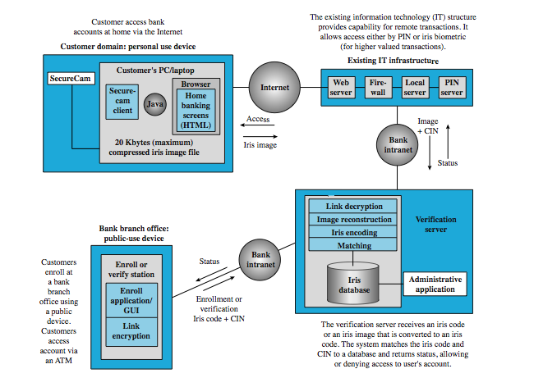
Practical Application
Notes:
As an example, we look at an iris biometric system that was developed for use in the banking industry for authentication of debit card users. Figure 3.12 here shows a generic version of this system, which is now in use commercially in a number of locations worldwide. There is considerable interest commercially in the use of an iris biometric system for this application because of its exceptional accuracy (see Figure 3.10) and because the biometric itself can be acquired without the individual having to come into physical contact with the biometric acquisition device. The system is designed to operate with automated teller machines (ATMs) in public places as well as with personal use devices that can be installed at home. For ATMs, a wide-angle camera finds the head of the person to be identified. A zoom lens then targets in on the user’s iris and takes a digital photo. A template of concentric lines is laid on the iris image and a number of specific points are recorded and the information converted into a digital code. For personal-use systems, a low-cost camera device involves more cooperative action on the part of the user to focus and capture the biometric. A customer must initially enroll through a public-use ATM device owned by the bank. The biometric is converted into a numeric iris code. This code and the customer identification number (CIN) are encrypted and transmitted over the bank’s intranet to a verification server. The verification server then performs the user authentication function. A user may employ a personal-use device to access the system via the Internet. The image information plus the CIN are transmitted securely over the Internet to the bank’s Web server. From there, the data are transmitted over the bank’s intranet to the verification server. which does the conversion of iris image to iris code. Initial field trials of the system showed very high acceptance rate of customers preferring this method to other user authentication techniques,such as PIN codes.

Slide 43
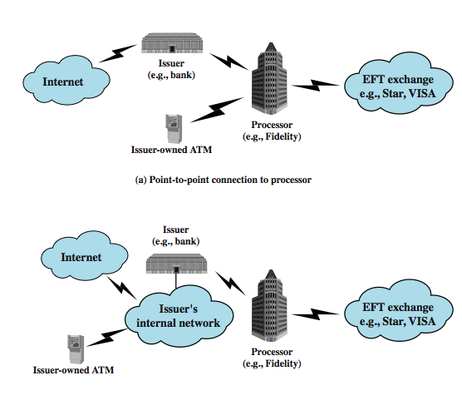
Case Study: ATM Security
Notes:
Section 3.8 in the text discusses a security vulnerability in ATM (automated teller machine) usage that affects a number of small to mid-size ATM card issuers. Customers expect 24/7 service at ATM stations. For many small to mid-sized issuers, it is more cost-effective for contract processors to pro-ide the required data processing and EFT/ATM services. Each service typically requires a dedicated data connection between the issuer and the processor, using a leased line or a virtual leased line. Prior to about 2003, the typical configuration involving issuer,processor, and ATM machines could be characterized by Figure 3.13a. The ATM units linked directly to the processor rather than to the issuer that owned the ATM, via leased or virtual leased line. The use of a dedicated link made it difficult to maliciously intercept transferred data. In the early 2000s, banks worldwide began the process of migrating from an older generation of ATMs to new systems. Because issuers typically run their own Internet-connected intranets, it was attractive to connect ATMs to these issuer networks and maintain only a single dedicated line to the processor, leading to the configuration illustrated in Figure 3.13b. This configuration saves the issuer expensive monthly circuit fees and enables easier management of ATMs by the issuer. In this configuration, the information sent from the ATM to the processor traverses the issuer’s network before being sent to the processor. It is during this time on the issuer’s network that the customer information is vulnerable. A hacker tapping into the bank’s network, either from an internal location or from across the Internet potentially would have complete access to every single ATM transaction. The system has two principal vulnerabilities: confidentiality and integrity, as the text discusses.

Slide 44
Summary
Introduced user authentication
  using passwords
  using tokens
  using biometrics
Remote user authentication issues
Example application and case study
Notes:
Chapter 3 summary.

